Slide 1
Online Bakery Website
Information communication and technology (ICT) Semester project
By: Iqra Agha and Meerab Hanif
Submitted to: Sir Umer Khattak

Slide 2
Project Overview
Project Title:
CakeBakery – Online Cake & Dessert Ordering Website
Objective:
To create a visually appealing and user-friendly online platform for a bakery that allows customers to explore cakes, cupcakes, and donuts, learn about the brand, and place online orders with convenience.
Key Features:
Top Bar Contact Info:
Displays phone number and email for quick customer support.
Responsive Navigation Header:
Includes navigation links: Home, Our Cakes, Menu, About Us, Shop, Contact Us.
Hero Section:
Showcases the brand slogan with a background image and call-to-action button ("See the recipe").
Featured Cakes Section:
Displays visually appealing images of selected cupcakes with names and prices.
Each item links to a detailed product page.

Slide 3
Cont.
5.Menu Section:
Categorized into Cakes, Cupcakes, and Donuts.
Shows name and price of each item.
“Add to Cart” buttons included (functionality can be added later with JavaScript).
6.About Us Section:
Brief overview of the bakery’s philosophy and mission.
7.Shop Section:
Highlights services such as fresh baking, customization, fast delivery, secure checkout, and pickup options.
Includes a shopping CTA button (“Start Shopping Now”).
8.Contact Section (Footer):
Provides multiple contact options for customer support.

Slide 4
Cont.
Color Scheme: Soft and appetizing palette using shades of pink (#f8a9b6) and white.
Typography: Combines playful and modern fonts (Playfair Display for headings, Open Sans for content).
Layout: Clean and structured layout using Flexbox and Grid for responsiveness.
UI/UX Elements:
Hover effects on buttons and navigation.
Cards for products with box-shadow and hover animation.
Cart buttons for future e-commerce functionality.

Slide 5
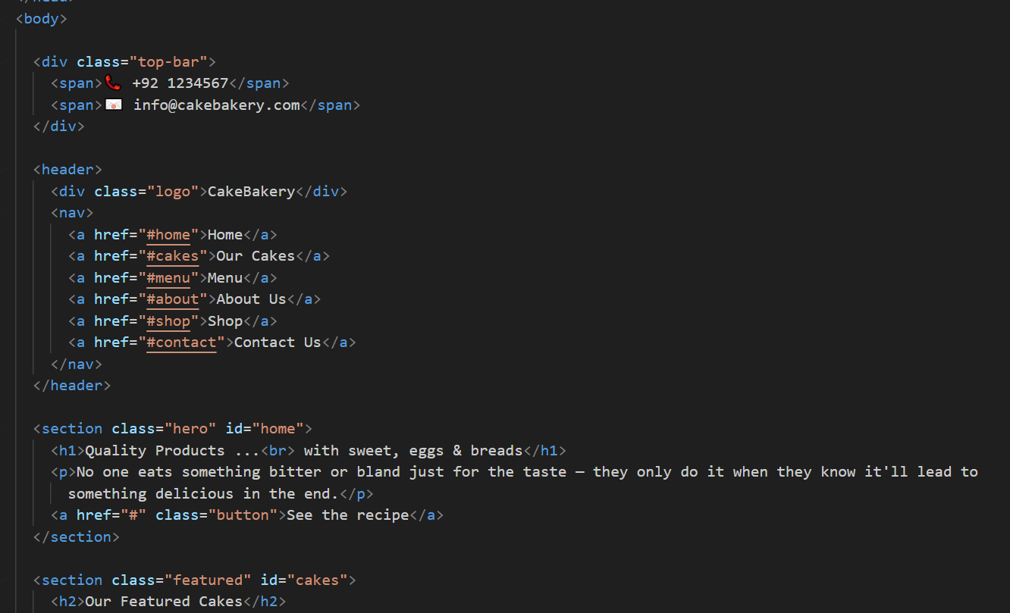
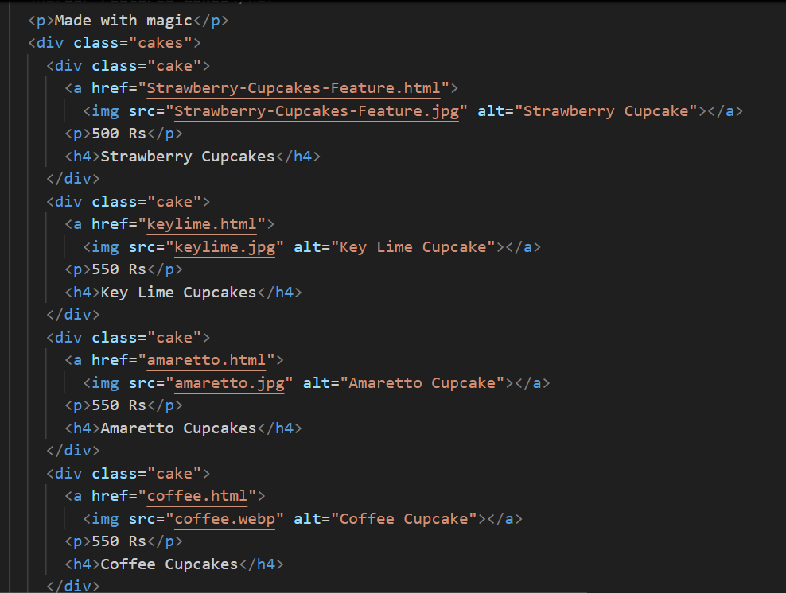
HTML (Structure)

Slide 6
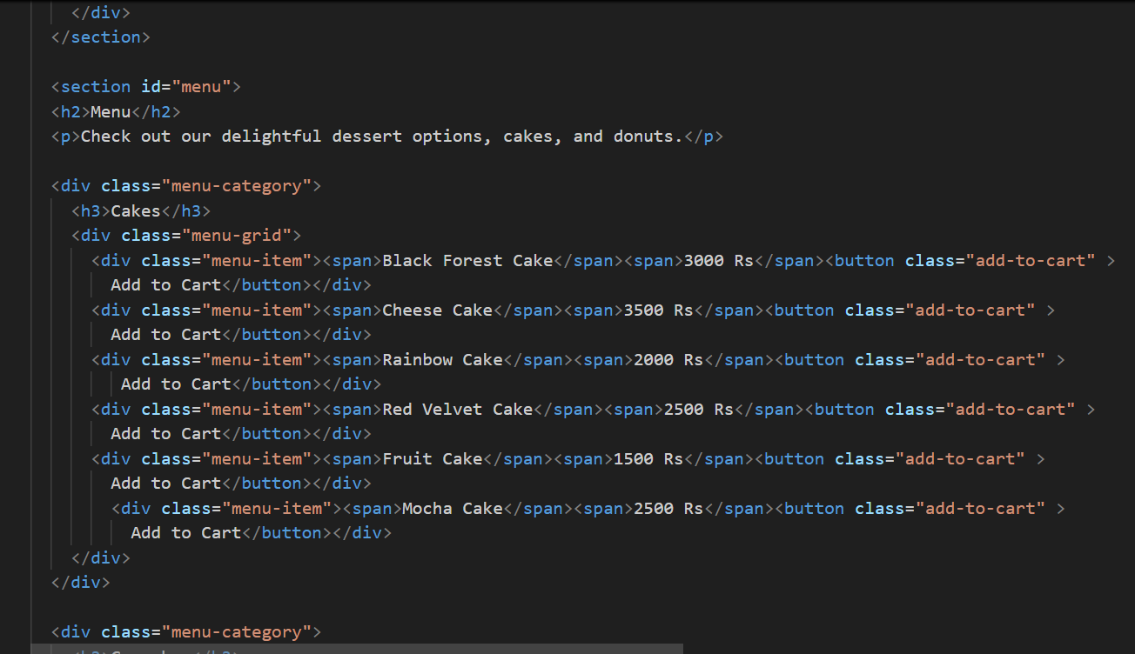
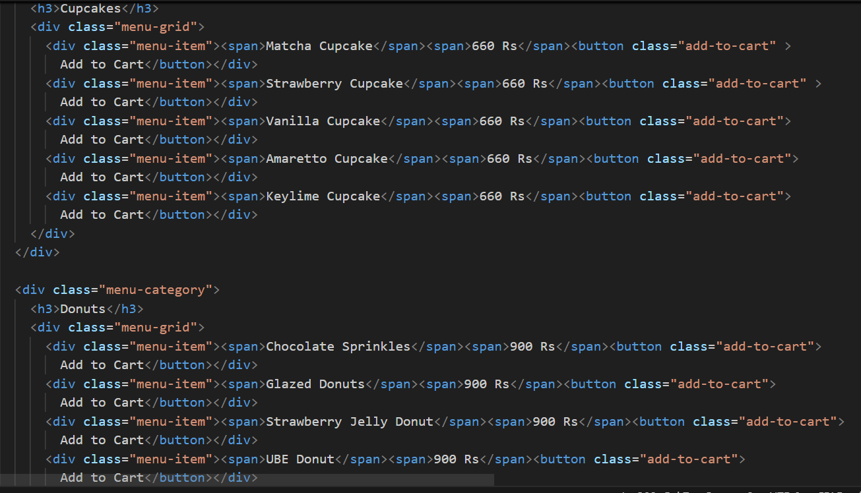
HTML (Structure)

Slide 7
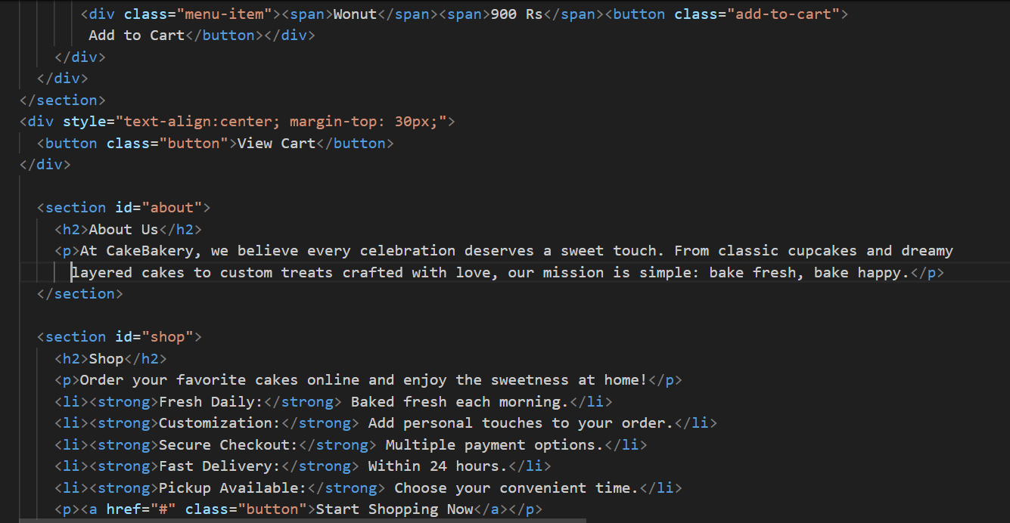
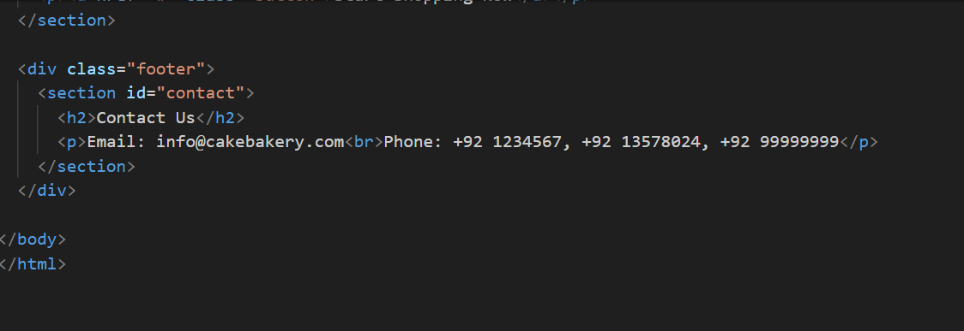
HTML (Structure)

Slide 8
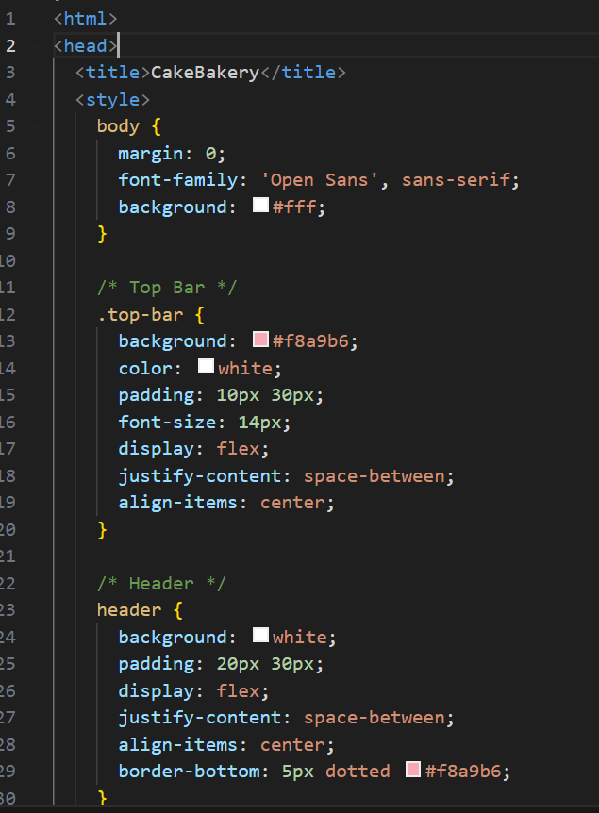
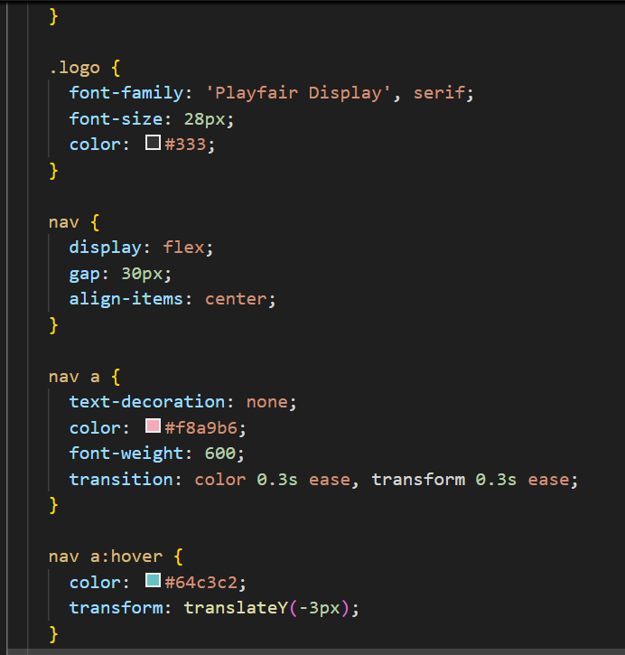
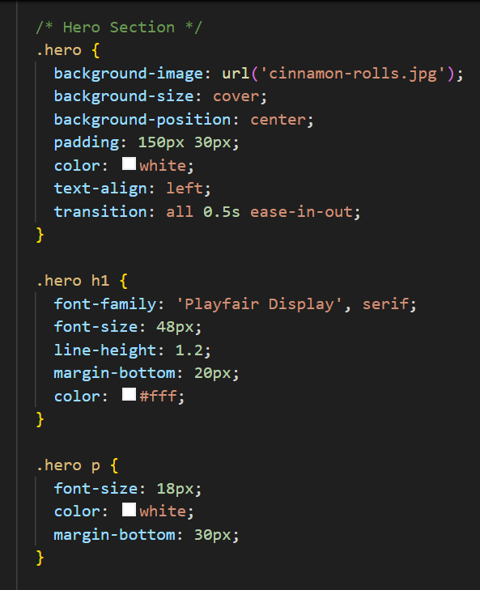
CSS (Styling)

Slide 9
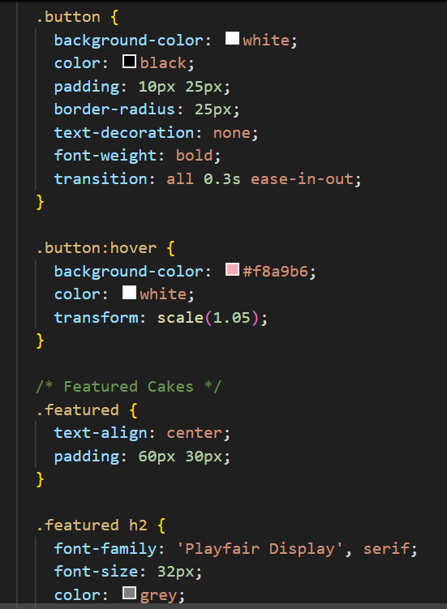
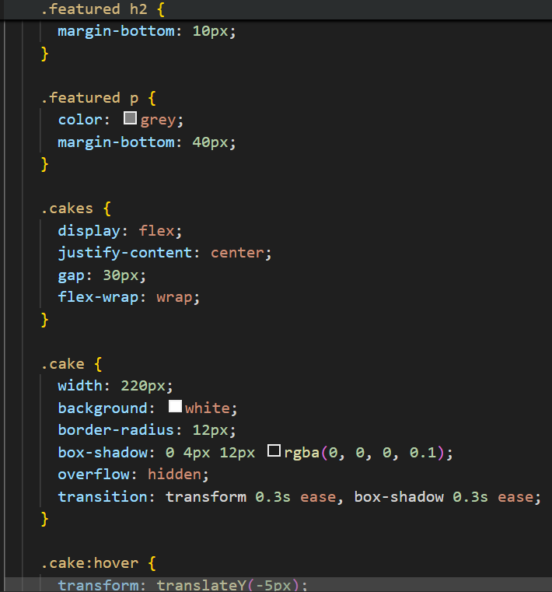
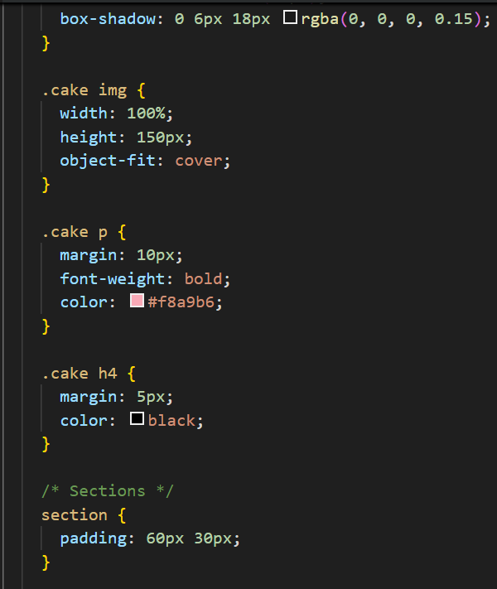
CSS (Styling)

Slide 10
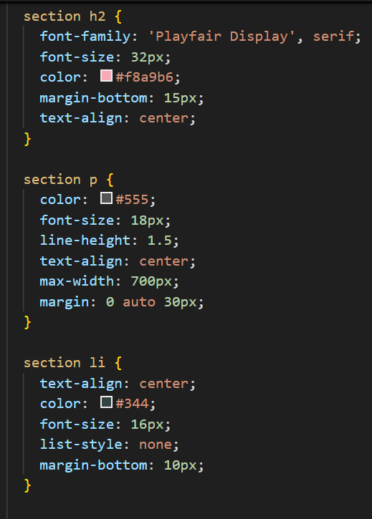
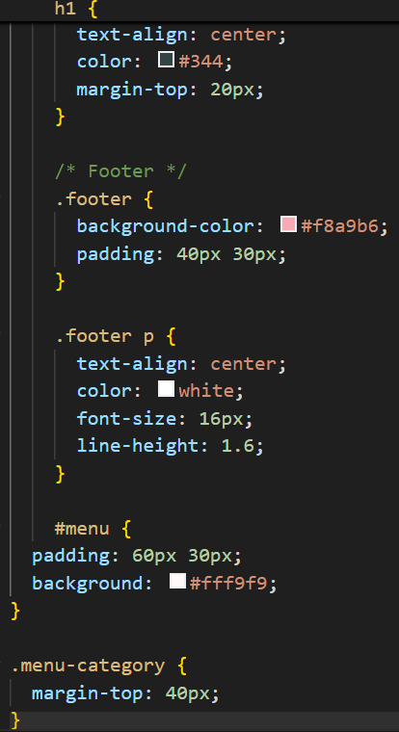
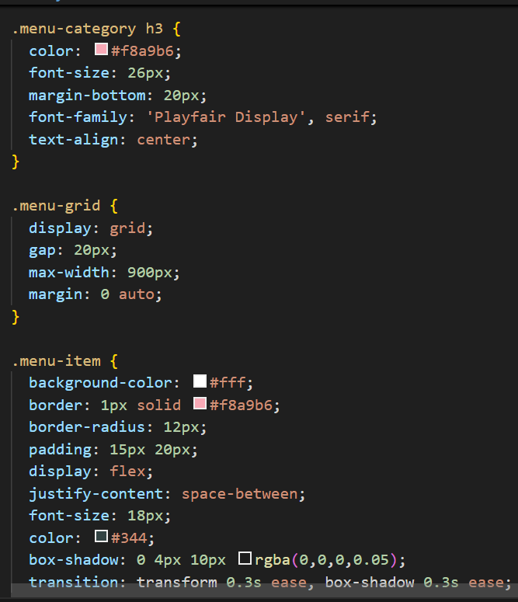
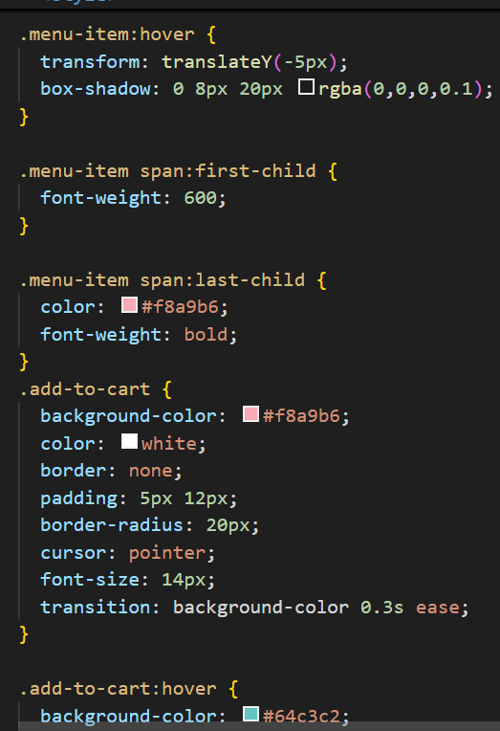
CSS (Styling)

Slide 11
Future Enhancements
Add JavaScript to enable shopping cart functionality.
Implement a checkout form with payment integration.
Connect to a backend (like Firebase or PHP/MySQL) for order storage.
Make the site fully mobile responsive with media queries.
Enable login/registration for users.

